Slide 1
M
A
R
C
H
2
0
1
3
Medical Emergencies in the Dental Office
Medical Emergencies in Life
Utah Dental Association
Salt Lake City, UT
Mel Hawkins, DDS
Dentist/Dentist Anesthesiologist
Toronto, ON Canada
www.sedationdentistry.us melhawkins@rogers.com

Slide 2
Emergency Protocol
“How can we as health professionals, who are supposed to have higher skills, be expected to treat an emergency situation in the office or in life when they NEVER (well, almost never) occur?”

Slide 3
Are we facing an:
ANNOYANCE?
URGENCY?
EMERGENCY?
N/A EVENT?

Slide 4
“Emergency” n=30,608
ANNOYANCES:
Syncope 15,407
Mild Allergy 2,583
Postural Hypotension 2,475
Hyperventilation 1,326
Epinephrine Reaction 913
Martin & Ellis JADA 112:499-501, 1986 Malamed JADA 124:4-53, 1993

Slide 5
“Emergency” n=30,608
URGENCY:
Syncope 15,407
Angina 2,552
Seizure 1,595
Bronchospasm (asthma) 1,392
Epinephrine Reaction 913
Insulin Shock (conscious) 890
Martin & Ellis JADA 112:499-501, 1986 Malamed JADA 124:4-53, 1993

Slide 6
“Emergency” n=30,608
EMERGENCY:
Syncope 15,407
Angina 2,552
Insulin Shock (unconscious) 890
Anaphylaxis with Bronchospasm 304
Myocardial Infarction 289
Local Anesthetic Overdose 204
C.V.A 68
Martin & Ellis JADA 112:499-501, 1986, Malamed S JADA 124:4-53, 1993

Slide 7
“Emergency” n=30,608
N/A:
Acute Pulmonary Edema 141
Diabetic Coma 109
Adrenal Insufficiency 25
Thyroid Storm 4
Martin & Ellis JADA 112:499-501, 1986, Malamed S JADA 124:4-53, 1993

Slide 8
Emergency Protocol
Is 911 a false sense of security?
IT DEPENDS on:
What,
When and
Where the problem is!

Slide 9
Emergency Protocol
YES! 911 is one
“When in doubt,
ship them out” solution!
The PROBLEM is what to do
with them in the meantime?

Slide 10
Communications:
Front Desk
Office Manager
911

Slide 11
Emergency Protocols
What is your
emergency?

Slide 12
Emergency Protocols
The 3 “U’s”
Unconscious
Unresponsive
Unable to find a
Pulse

Slide 13
Emergency Protocol
Attending person’s
RESPONSIBILITIES: 911
“I HAVE AN UNRESPONSIVE CHILD WITHOUT A PULSE.
123 Home Street at Lawn Blvd., Hawkins residence. Front door. I will meet you there.”

Slide 14
Emergency Protocol
FRONT DESK
RESPONSIBILITIES: 911
“WE HAVE A PATIENT IN CARDIAC ARREST WITH CPR IN PROGRESS
91 Rylander Blvd., Dr. Hawkins office.
Front parking lot. I will meet you there.”

Slide 15
Emergency Protocol
ALL THE STAFF MUST KNOW LOCATION OF:
Portable oxygen with masks/cannulas
BVM Ambu® bag with airways
A.E.D.
Emergency drug kit
Portable suction
Emergency lighting source
E.C.G. monitor

Slide 16
Staff Training
Current BLS training
Task designation: 2 groups,
action gp./support gp.
Mock simulations: less time/more frequency

Slide 17
Staff Training
NOTE:
Can you discover, privately, without embarrassment who is and who may not be prepared for an assigned duty before an event, not during.

Slide 18
Staff Training
Mock Simulations:
Every 2 Months
15 Minutes - Syncope

Slide 19
Syncope Algorithm:
Position, ABC’s
Time, Time, Time
⬇
Always! - O2 by nasal cannula
4 litres / minute
+ Glucose

Slide 20
Medical Consultation
?
?
?
Phone etiquette

Slide 21
Medical Consultation
…Brrrrinnggg…
“Hey, Doc. How do I treat your medically compromised patient?”

Slide 22
Medical Consultation
HAVE A GAME PLAN!
Medical risk vs. Tx benefit
Contemplated medications in mg. or μg.
MD scrawling “BP is 240/120 but fine for dental treatment” on Rx pad is NOT a mandate!

Slide 23
EMERGENCY KITS
Ready made
Self assembled?
Acme™ Dental /
Medical Kit

Slide 24
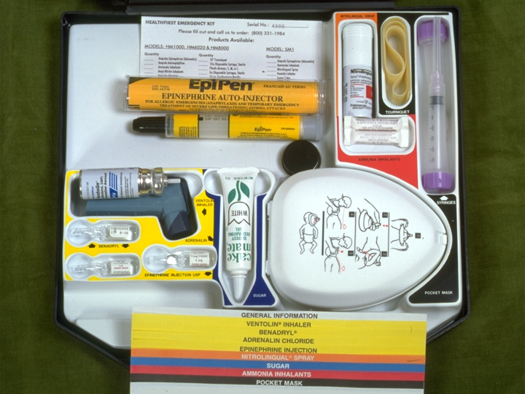
OLD DAYS: nice suitcase and color coded micro-print

Slide 25
Pharmacodynamic Age and Risk
The Senior Citizen.
Although inaccurate, a “senior” in our society is usually defined as 65 years old (unless in a Drug Store on Tuesdays).
A “bad day” will usually happen because of an attack of a pre-existing condition.
Notes:
_{February 2005}
_{Dr. M. Hawkins - Sedation}
₂₅

Slide 26
Pharmacodynamic Age and Risk
The Child.
Although inaccurate, a “child” in our society is usually defined as up to 12 years old
A “bad day” will usually happen because of lack of respect of their airway...
Notes:
_{February 2005}
_{Dr. M. Hawkins - Sedation}
₂₆

Slide 27
Pharmacodynamic Age and Risk
The “Mid-age” Patients.
ASA I or II are generally very safe patients. ASA III is a judgment call. A “heart” patient is safer with sedation.
A “bad day” will usually happen because of lack of attention to rules - doses, lack of good L.A. or “point of no return” feelings
Notes:
_{February 2005}
_{Dr. M. Hawkins - Sedation}
₂₇

Slide 28
Geriatric
Considerations
The “Fear” Factor
Loss of function and independence
Long term institutionalization and isolation
Disability
Death
Notes:
_{February 2005}
_{Dr. M. Hawkins - Sedation}
₂₈

Slide 29
Geriatric
Considerations
C.N.S:
  Loss of Neurons
C.V.S:
  Systolic B.P. ⬆ with age
  Rate ⬇ due to parasympathetic activity
Notes:
_{February 2005}
_{Dr. M. Hawkins - Sedation}
₂₉

Slide 30
Geriatric
Considerations
Pulmonary:
  Loss of alveolar septa
  ⬇ elasticity of lungs
  Chronic smoking a factor
Notes:
_{February 2005}
_{Dr. M. Hawkins - Sedation}
₃₀

Slide 31
Geriatric
Considerations
COMMUNICATION
DIFFICULTIES!
Notes:
_{February 2005}
_{Dr. M. Hawkins - Sedation}
₃₁
Find graphic for communication difficulties – clip of characters not communicating – cartoon ie. Sedation presentation – under consent section

Slide 32
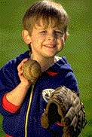
DOSAGES
FOR
CHILDREN
TOXICITY

Slide 33
Pediatric Considerations
C.V.S / C.N.S:
↓THE 2 MOST IMPORTANT Physiological Considerations
IN PEDIATRIC RESCUE are:
High MYOCARDIAL - MVO2
High BRAIN – CNS “VO2”

Slide 34
Pediatric
Considerations
C.N.S:
The CPR / BLS guideline of:
“3 – 6 minutes until permanent brain damage begins” is for the adult without an O2 debt and does NOT apply in pediatric life.
IT’S MORE IN THE ORDER OF 1 MINUTE!

Slide 35
Pediatric
Considerations
Drug (local anesthetic) impact:
Unpredictable
Blood Brain Barrier: is immature
➲ Metabolism due to immature liver

Slide 36
Pediatric
Considerations
COMMUNICATION
DIFFICULTIES!

Slide 37
Equipment Adjunct Management
It is ideal to be able to use the emergency armamentaria in day-to-day dentistry, for cost efficiency, familiarity and for practice!

Slide 38
Management of Airway
Actions & Armamentarium

Slide 39
Airway Considerations
Know Each Patient’s Airway
Always Maintain Patency
  Head Position
  Clear Debris
Use Throat Partitions
Use Rubber Dam When Possible

Slide 40
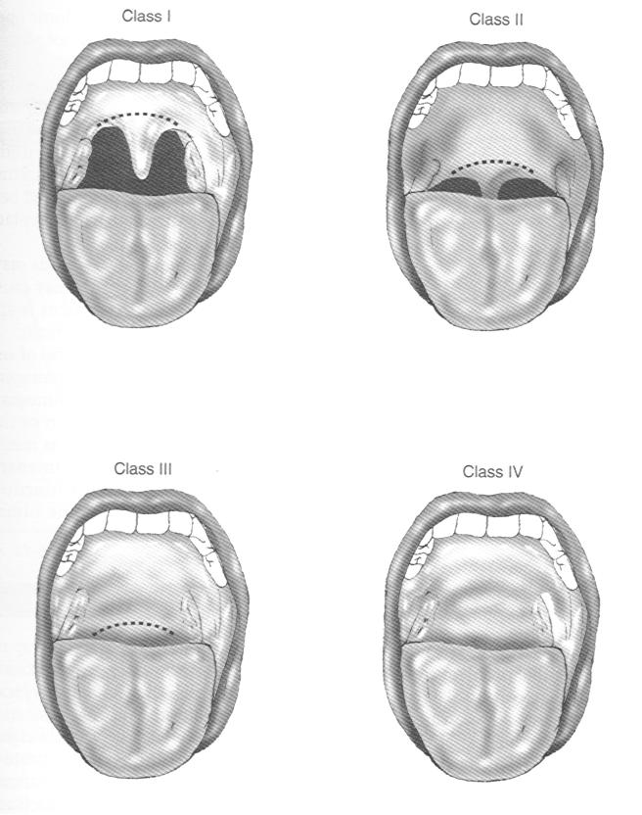
Mallampati Classes
I
II
I: uvula, soft palate line and pharynx fully visible
II: uvula, pharynx partially visible, soft palate line visible,
III: uvula, pharynx NOT visible, soft palate line questionable
IV: nasopharynx, uvula completely invisible
III
IV

Slide 41
Airway
Obstructions
The
Conscious
Victim

Slide 42
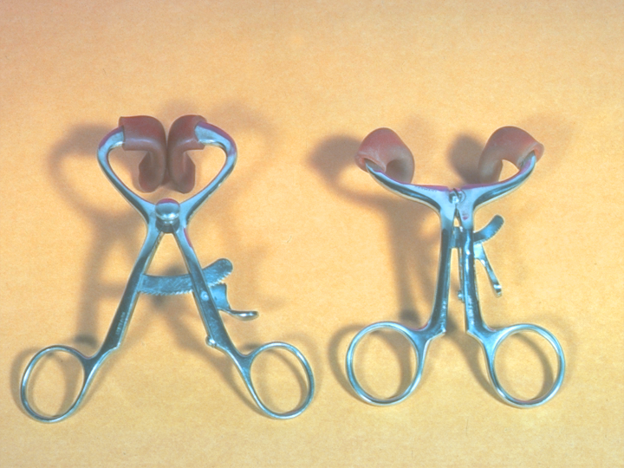
“Mouth Rester”…not a prop

Slide 43
Don’t
Swallow!

Slide 44
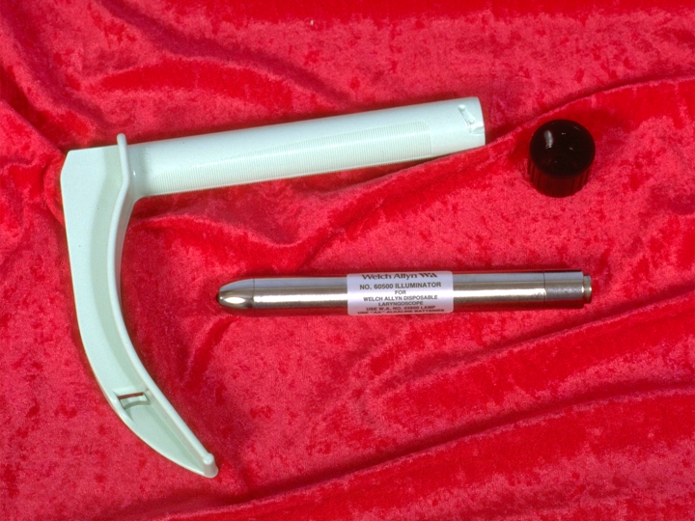
Disposable Laryngoscope
“A tongue depressor
with a light on it”

Slide 45
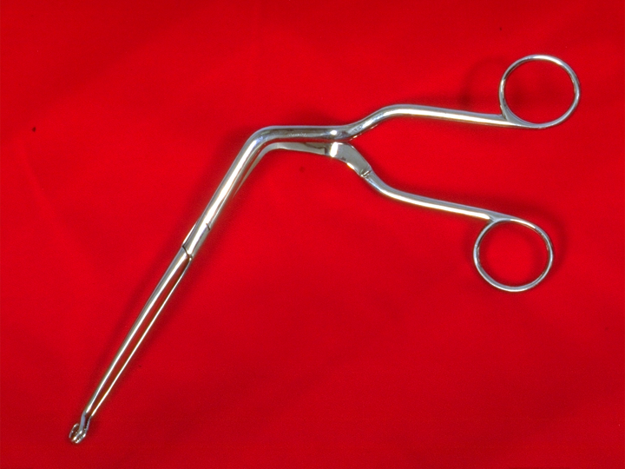
Magill Forceps
➔ Serated, circular tips, double lumen

Slide 46
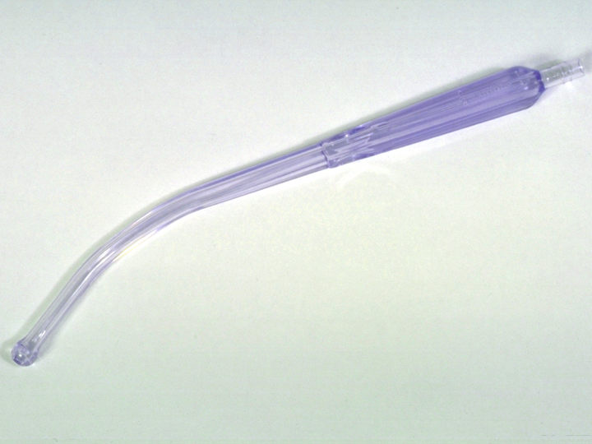
Disposable, “long saliva ejector”
With a screen tip that
doesn’t come off

Slide 47
Airway
Obstruction
The
UNConscious
Victim

Slide 48
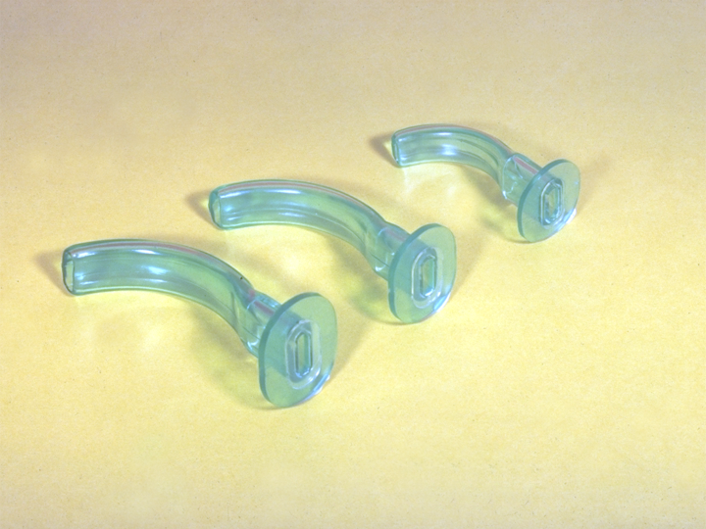
Size? Angle of Mandible to
Corner of Mouth

Slide 49
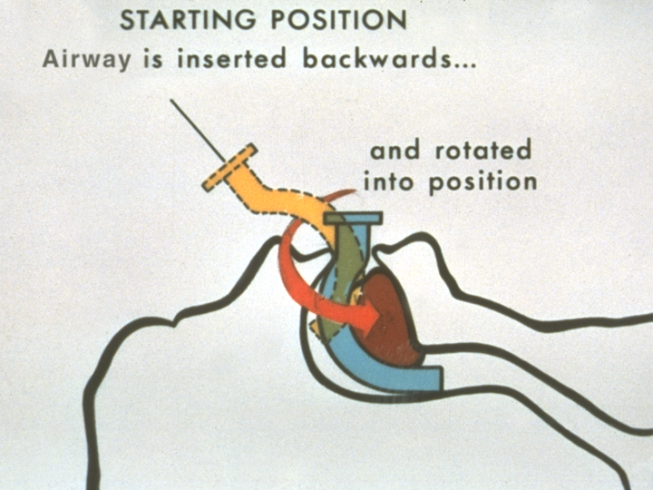

Slide 50
Cricothyrotomy
Old and New Ideas

Slide 51
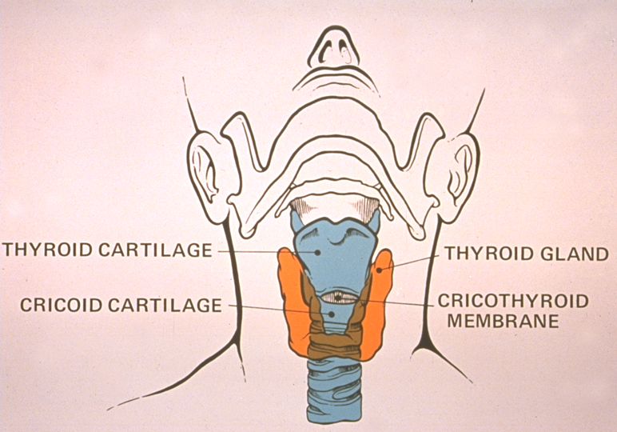

Slide 52
Management of Breathing
Actions & Armamentarium

Slide 53
Oxygen Sources
Portable tanks (Stem & Wrenches)
Central tanks
    Regulators and Components
    Flow meters

Slide 54
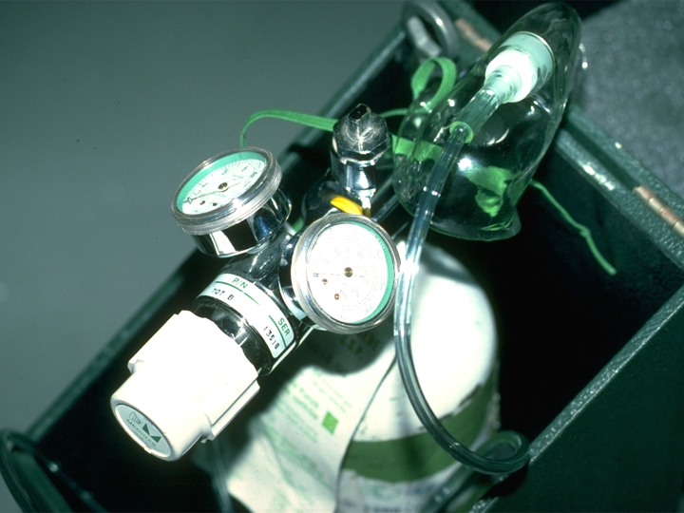
Flow meter:
0-15 liters/min
Full:
2000
PSI

Slide 55
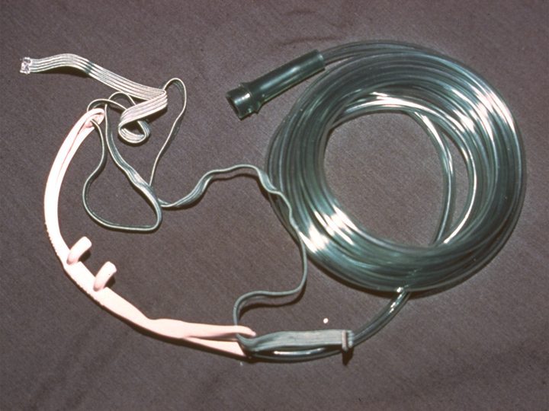
Nasal Cannula - Disposable
O2

4 l/
min

Slide 56
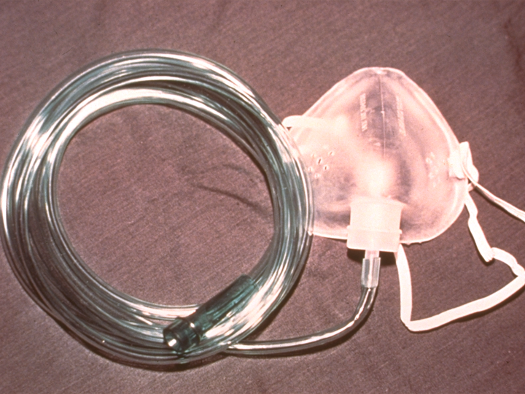
Non-rebreathing Mask (NRB)
O2

6-10
l/min

Slide 57
Bag-valve-mask
Systems (B.V.M.)

Slide 58
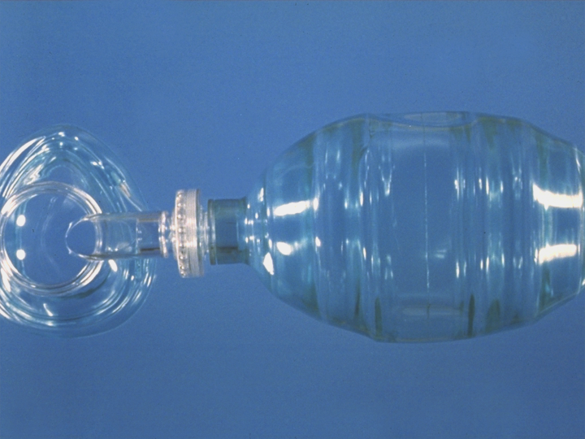
Bag Valve Mask (BVM)
Inflatable Mask
(use 10 cc. syringe – air)

One way valve- once sealed
 no need to lift edge for exhalation
        Supplemental O2 with  reservoir at 10-15 liters/minute
        2 – 3 L. bag

Transparent –
can see regurgitation
CAN BE USED if BREATHING!

Slide 59
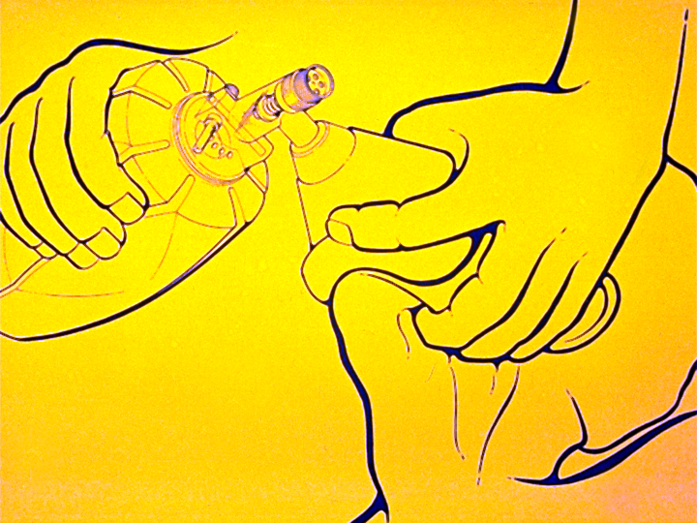
These 2 digits press ⬇
⬆
These 3 fingers pull
up

Slide 60
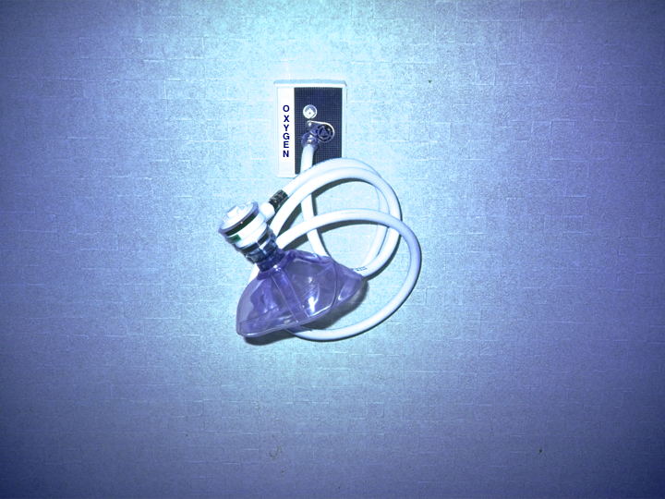
Demand Valve
NOT Recommended

Slide 61
Management of Circulation
Actions & Armamentarium

Slide 62
VASOCONSTRICTOR
“ISSUES”

Slide 63
Vasoconstrictor Considerations
Use is based on vasoconstrictive alpha receptor agonists
  1. Delays absorption, reducing toxicity and prolonging duration
  NO ADVANTAGE WITH CONCENTRATIONS > 1:200,000
  2. Reduces hemorrhage at surgical site
  (CONCENTRATION IS ADVANTAGEOUS IN THIS CASE)

Slide 64
Vasoconstrictor
Considerations
Adrenergic alpha receptor functions and vascular distribution
  α Vasoconstriction
  Vasodilation/Bronchodilation
  β₁ Cardiotropic
Veins and
Submucosal
Arteries
Deep
Arteries
β₂
  α
α
β₂
Notes:
Title…sub title and 2 boxes….a b2 and b1 together with arrows – then words following a b2 and b1 in one bath – then graphics diagram

Slide 65
Vasopressor Considerations
Relative Receptor Affinities:
  Epinephrine 50:50 alpha:beta 1=2 receptor affinity
  Levonordefrin 75:25 alpha:beta 1 receptor affinity
    These often cited ratios are misleading since they reflect levonordefrin’s limited action at beta 2 receptors. Its activity at cardiac beta 1 receptors is comparable to epinephrine’s at equipotent doses

Slide 66
True - False
In most heart conditions the vasoconstrictor is the Dentist’s and Patient’s most serious medical / dental risk for dental treatment

Slide 67
Vasoconstrictor Considerations
Posology
Concentration represent grams / ml
  1. 1:100,000 = 0.01 mg or 10 µg per ml
      1:50,000 = twice the amount or 20 µg
      1:200,000 = half this amount or 5 µg

Slide 68
Vasoconstrictor Considerations
Systemic influences following absorption are UNEQUIVOCAL
  Systemic absorption WILL occur!
  Rate / Pressure Product WILL increase!
  Issue is whether this effect is detrimental to patient.
Potential for enhanced pressor response in those patients medicated with nonselective beta blockers.
  Low doses of epinephrine exhibit beta₂ preferences on systemic arteries.
  If beta blockade is present, epinephrine will bind with alpha receptors and increase peripheral resistance.

Slide 69
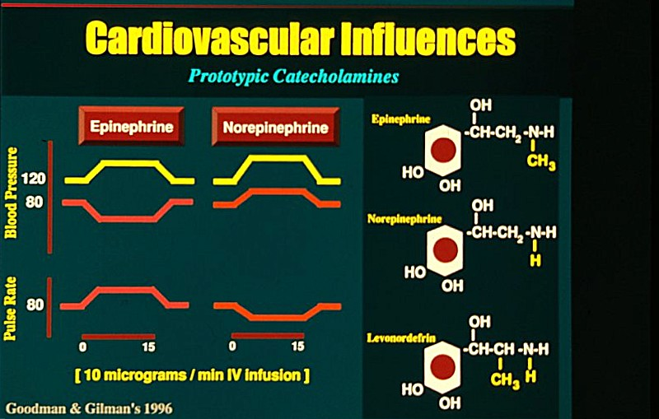
Epi Levo

Slide 70
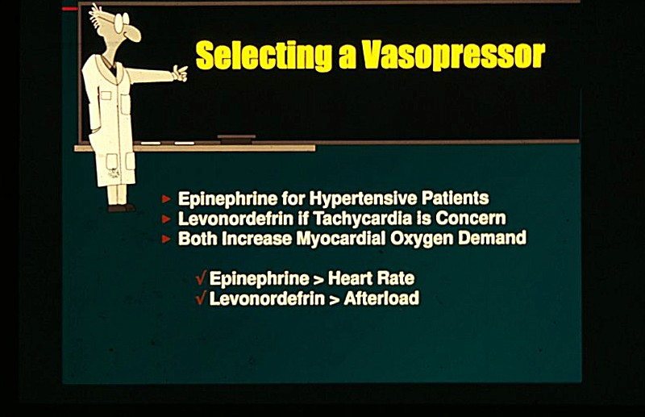

Slide 71
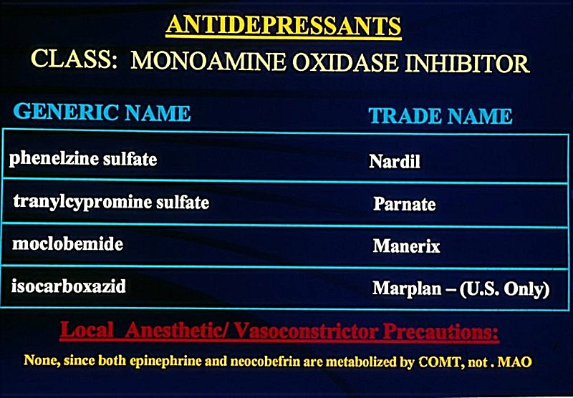

Slide 72
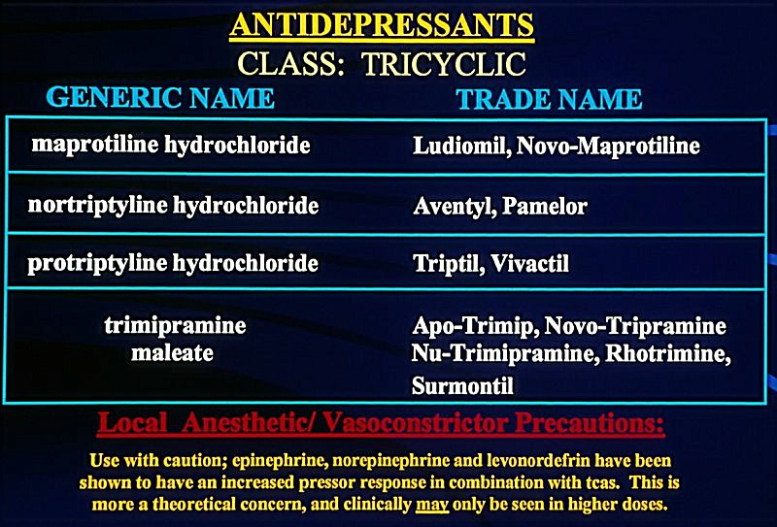

Slide 73
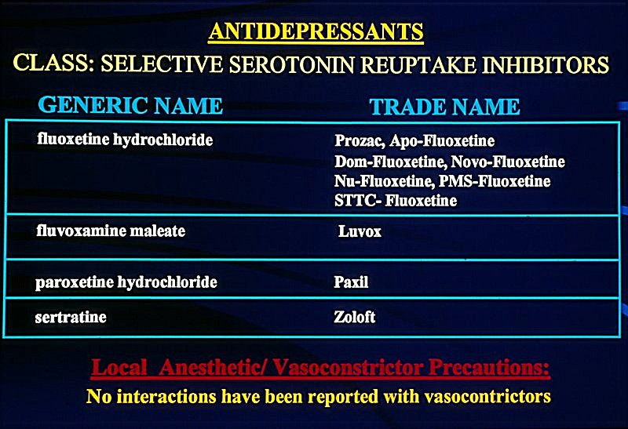

Slide 74
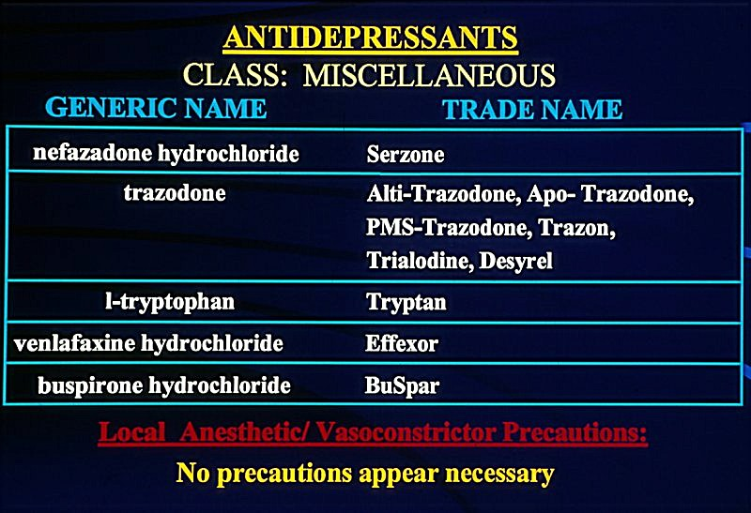

Slide 75
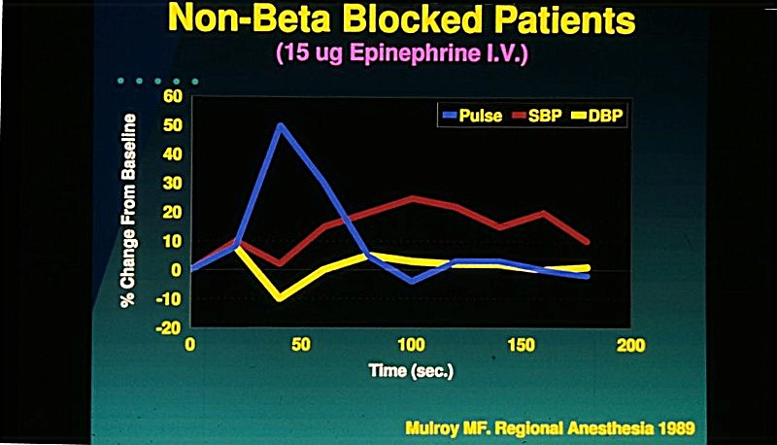
Normal

Slide 76
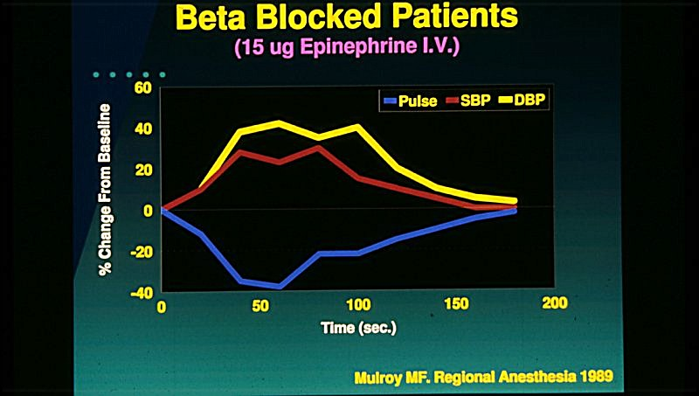
Both β1, β2 blocked
Notes:
Pull picture into graphics and rotate slightly

Slide 77
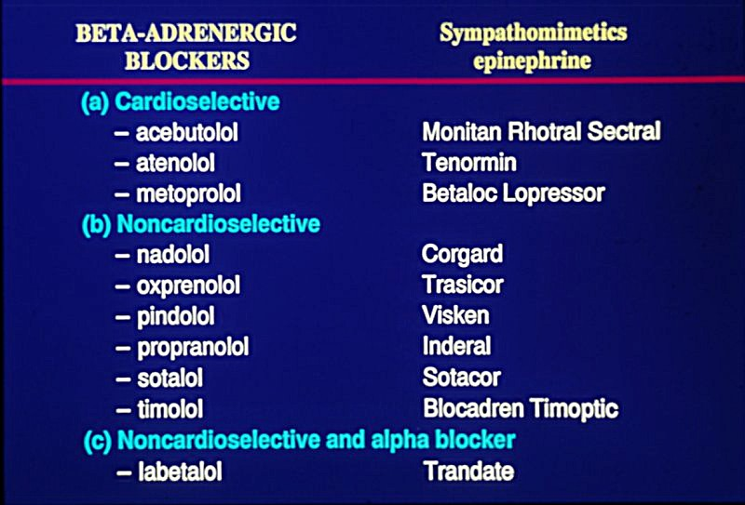
“alright” β 1 blocked only
“beware” β 1,2 both blocked
“cool” all
blocked
Notes:
Ask dave – blurry!

Slide 78
Managing Beta Blocked Patients
No issue with cardioselective agents, (a) category
BUT
Inderal™ and Corgard™, non-selective, (b) category
WHAT TO DEFINITELY DO!
Look it up in the PDR (CPS Canada)
Wait 5 minutes after each cartridge and reassess vitals
Notes:
Tm VS r

Slide 79
Managing Beta Blocked Patients
WHAT TO POSSIBLY DO?
Avoid using a vasopressor if (b) category
Consult physician (?) regarding discontinuing (b) beta blocker or changing it to a cardioselective (a) beta blocker

Slide 80
Hypertension Algorithm
Syncope Protocol
Reassess BP / Perfusion
Nitroglycerin
Nifedipine
EMS transport if symptomatic

Slide 81
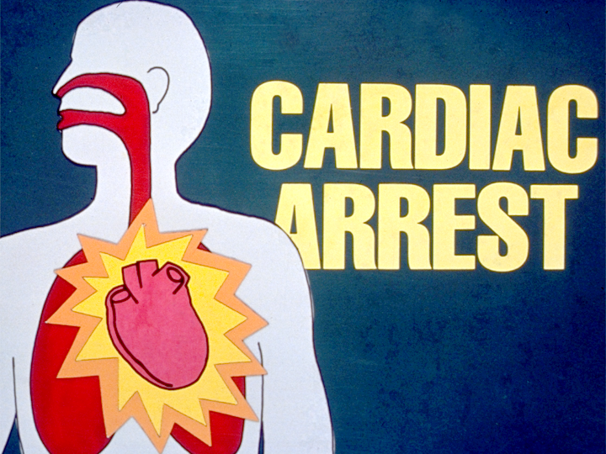

Slide 82
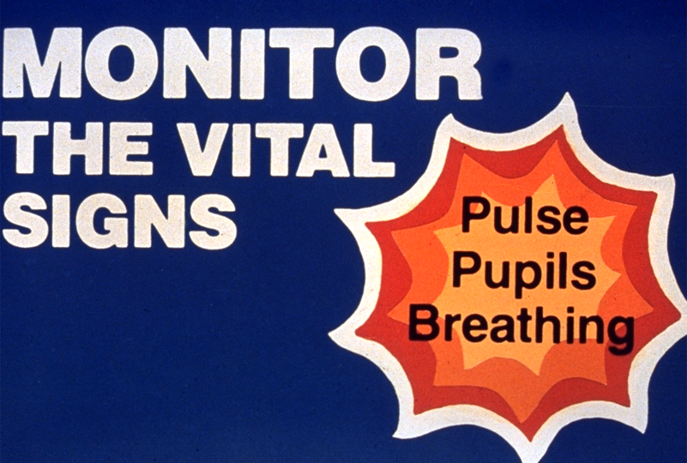

Slide 83
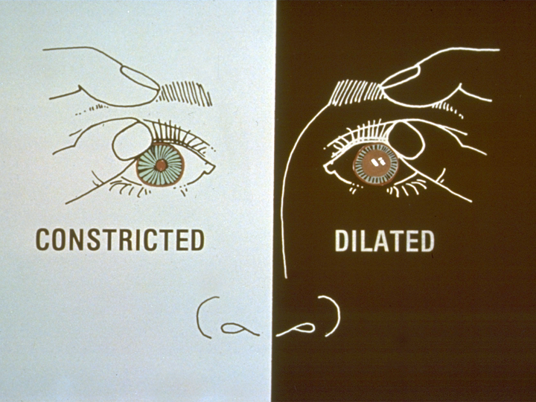

Slide 84
Victim
Must Be
On “Firm”
Surface ?

Slide 85


Slide 86
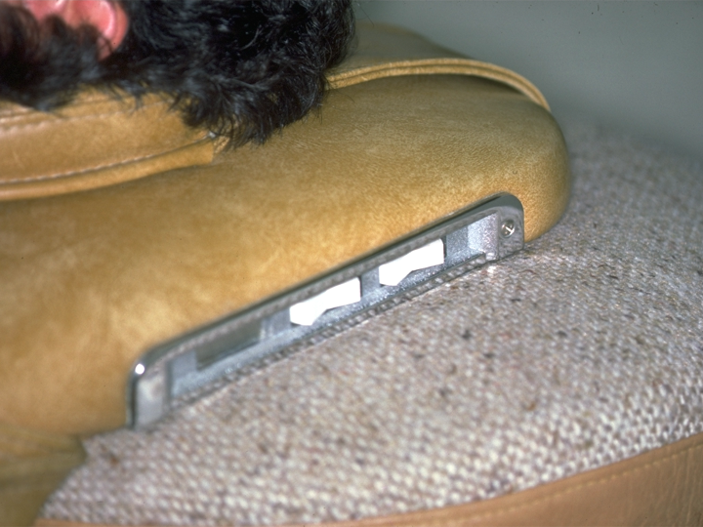


Slide 87
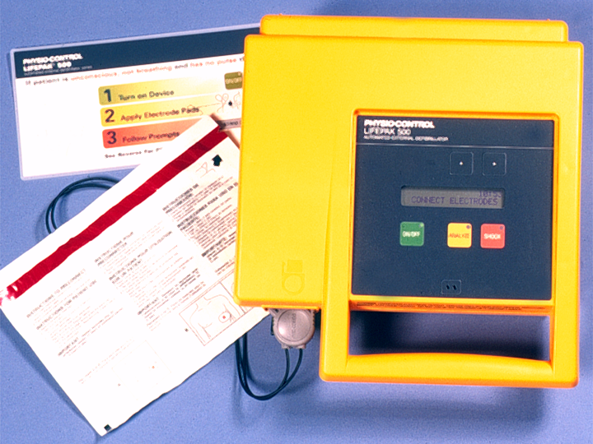

Slide 88
AED Philosophy
If you are State Board regulated to have one, then get one!
If you think that you might need one used on you, then get one.
If you think that the 2nd point above applies to you, then give your staff a raise and get one.
If none of the above apply, then don’t!

Slide 89
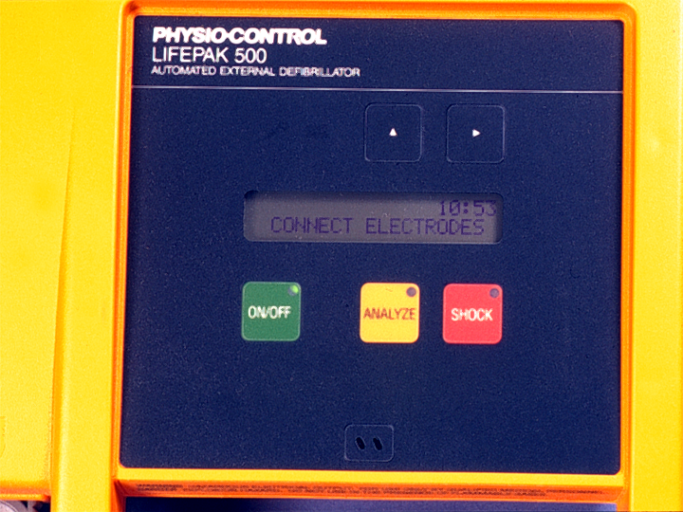

Slide 90
Let’s Do Drugs

Slide 91
Guidelines
What do you need?
DO NOT even THINK of using a drug you know nothing about!

Slide 92
Emergency Medications
Responsible Auxiliary:
Check kit on a monthly basis to assure drugs are not expired or broken. Replace as needed
Review correct method for preparation in emergency, periodically

Slide 93
OXYGEN

Slide 94
Epinephrine
EPI – PENS* for anaphylaxis (severe allergy; bee stings, peanuts) and bronchospasm
CHILD / ADULT: child: 0.1 mg. to 0.3 mg.
        cost $80.00
        adult: 0.3 mg. to 0.5 mg.
        cost $ 80.00
        *until you can draw up from an amp.

Slide 95
Epinephrine
        Equi-potent doses: (1ml 1:1000amps)
        by route of administration:
        SC - 0.5 mg
        IM – 0.3 mg.
        IL – 0.2 mg.
        IV – 0.1 mg. – must diluted 1:10,000
  If patient has air exchange ➔ beta - 2 inhaler: albuterol (Ventolin®)

Slide 96
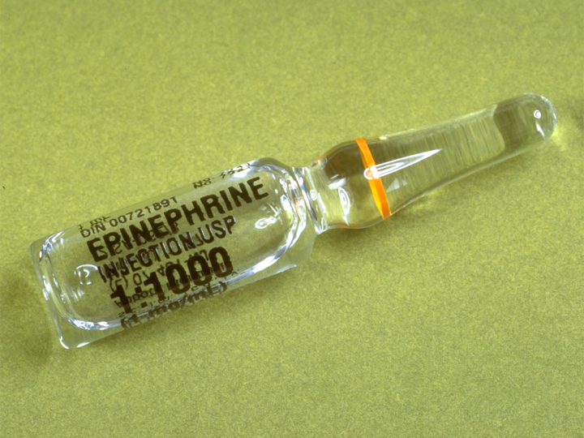

Slide 97
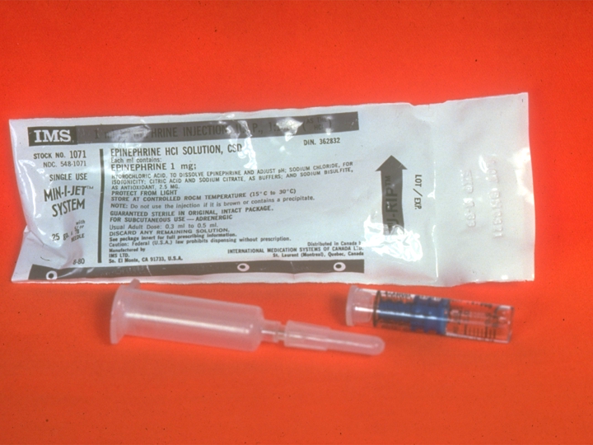

Slide 98
Nitroglycerin
Action is unclear: With SL administration,there is vasodilation domination resulting in a reduced venous
return, or preload reduction, lowering MVO₂
Indications / Dose: 0.3-0.6 SL mg. tabs,
0.4-0.8 SL spray
➔ Ischemic chest pain - 1 tab Q5M x 3
➔ Symptomatic hypertensive episodes
Warning: do not give another nitro if SBP < 90

Slide 99
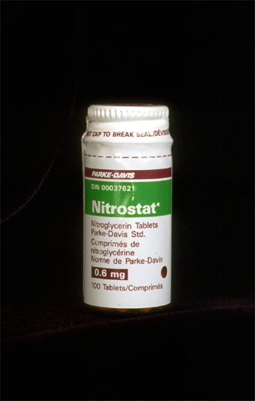
$9.00 / 100
Exp. date must be “Sharpied” to 8-10 weeks from “today’s seal breaking”

Slide 100
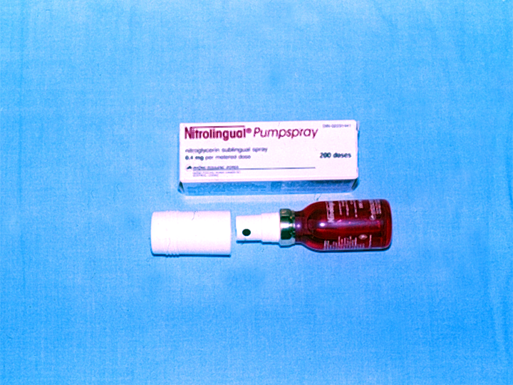
$32.00 per pump spray - but the expiry date IS the expiry date

Slide 101
ASA
? mg. giving the max. as a 324 mg. tab. is OK but…

Slide 102
ASA (for MI) and 324 mg. = peak effect
It’s best via 4X baby
ASA (81 mg.) chewed, aside from prophylactic use

Slide 103
ASA (for MI)
324 mg. = peak effect
Action: Keeps # of platelets from increasing, which could lead to ARREST! or if cerebral blockage, STROKE!

Slide 104
Ventolin®
Albuterol / Bronchodilator
  Inhaler: Inhale 1 to 2 puffs of albuterol up to 4 times daily.
  More than 8 inhalations per day is not recommended.

Slide 105
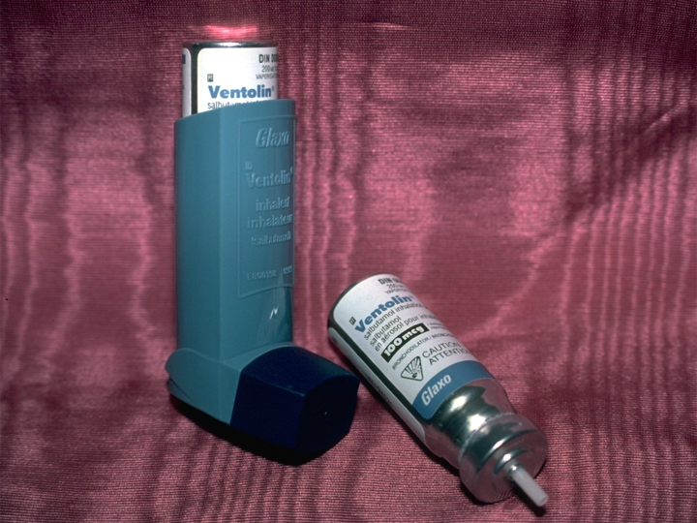
Albuterol - Ventolin® - a ß2 agonist

Slide 106
Diphenhydramine (Benadryl®)
Action and effect based on blocking histamine release
Indications / Dose: (50mg/ml amp or SDV)
  pruritus / urticaria / nausea
  50mg IM followed by 50mg TID P.O.
  medical follow up to anaphylaxis
  THINK FIRST! Can they get a ride?

Slide 107
Glucose Source
FACT: ALL dental offices have a massive sugar availability in house!

Slide 108
Resources for Emergency Drugs and Equipment
Sedation Resource, Inc: texasrose@sedationresource.com
www.sedationresource.com
800-753-6376
Hals Med Dent Supply &Pharmacy, Inc
www.halsmeddent.com
Southern Anesthesia & Surgical
www.southernanesthesia.com

Slide 109
Resources for Emergency
Drugs and Equipment
ACE Surgical Supply Company
1034 Pearl St. Brockton, MA
AAMOS Supplier Marketplace
800-816-6710 aaoms@multiview.com
www.multiview.com
Salvin Dental Specialties, Inc.
Criticare monitors, AED’s,
3450 Latrobe Dr. NC 28211
www.salvin.com

Slide 110
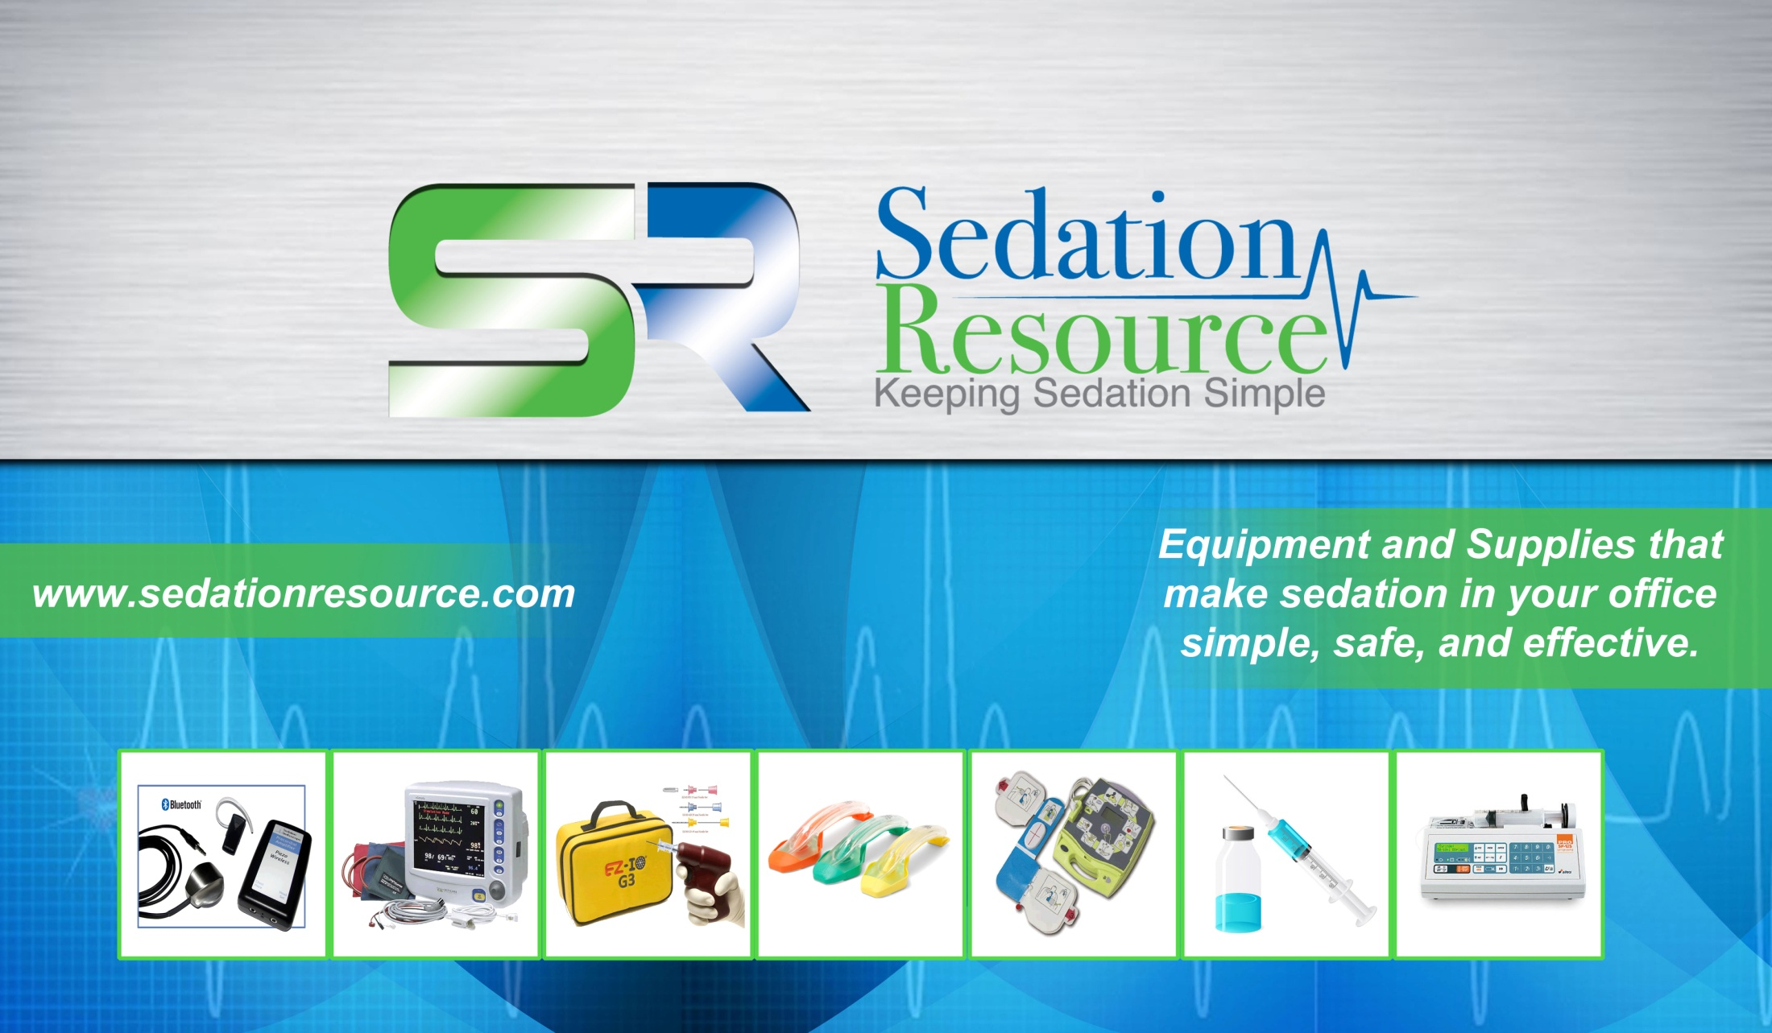
Small enough to give personal service,
but big enough to have everything you need

Slide 111
Diagnosis Dependent
Treatment

Slide 112
Syncope
Sudden, transient loss of consciousness
Common immediately pre- or post injection
Most common procedure – extraction
Often recovery before advanced treatment can be implemented

Slide 113
Syncope Profile of Prevalence
Male » Female
Never children
Average age? 35 years old
Scenario:
    Male, 35 y.o., anxious, “macho” guy, “needle”

Slide 114
Syncope – Signs / Symptoms
Pallor
Nausea
Disorientation
L.O.C.
 Blood pressure
Pulse thready, may arrest for 30-45 sec.
Low blood sugar

Slide 115
Syncope Causes
Anxiety, Pain
Sit up too fast
Inject too fast
Intraosseous injections
Hypoglycemia (prolonged NPO)

Slide 116
Syncope Algorithm:
Position, ABC’s
Time, Time, Time
⬇
Always! - O2 by nasal cannula
4 litres / minute
+ Glucose

Slide 117
Nausea / Vomiting
…associated with syncope

Slide 118
Hyperventilation –
Signs / Symptoms
Rapid, shallow breaths, “air hunger”
Impaired inspiration / expiration
Sense of panic
Disorientation
O2 saturation = 100%

Slide 119
Hyperventilation
It’s
Showtime!

Slide 120
Hyperventilation - Tx
Rebreathe from paper bag?
Cellophane bag??????
Do nothing and leave room
*Nobody’s ever died from a 100% oxygen saturation!

Slide 121
Angina / Myocardial Infarction
ANGINA:
Pallor, chest pain in “waves”
“Indigestion?”
Denial
Midsternal pain, left arm, left mandible
Nausea, diaphoresis
Rapid, shallow breathing Rx: 1 Ntg.

Slide 122
Angina / Myocardial Infarction
MYOCARDIAL INFARCTION:
Female: “weight on chest” / indigestion?
    mild SOB, nausea
Male: chest pain, sharp, severe, left arm
    ⬆ SOB, ⬆ BP (pain)
Panic, fear, but denial
Rapid, shallow breathing Rx: Not relieved by 3 Ntg.

Slide 123
Cardiac Emergencies - Usually related to Ischemic Heart Disease
SUPPLY
Atherosclerosis
Vasospasm
Thrombus
DEMAND
    Oxygen
    Heart/brain
    Tissue perfusion
Ischemia
Angina
Silent MI
Infarction
Aneurism
Heart Failure
Dysrhythmia
CARDIAC ARREST !

Slide 124
Angina / MI Algorithm
Syncope Protocol
⬇
Nitroglycerin q. 5 min x 3
⬇
Assume MI / Call EMS

Slide 125
Cardiac Arrest
  Marked hypotension
  Rapid, shallow breathing ➔ LOC ➔
  Apnea ➔ cyanosis ➔ respiratory
  arrest
  Fibrillation ➔ no pulse
  AED diagnosis

Slide 126
Cardiac Arrest Algorithm
Syncope Protocol
⬇
CPR
100% Oxygen
➔ 1 - 2 mg epinephrine

Slide 127
Acute Asthma ➔
Bronchospastic Events
“Asthma and Severe Allergy
Signs/Symptoms
Combination”

Slide 128
Bronchospasm
Algorithm
ABC’s & Position
⬇
Oxygen
⬇
B-2 inhaler epinephrine 0.3 mg

Slide 129
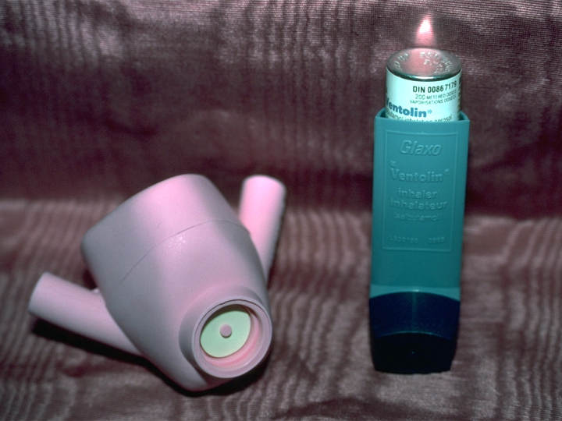
Oxygen
Albuterol,
Ventolin®

Slide 130
Hypersensitivity Reactions
MILD:
Flushed, red skin
Itching, prickling sensation
Mild SOB
Restless

Slide 131
Hypersensitivity Reactions
SEVERE:
Edema of lips, tongue, larynx, neck
⬆ SOB, shallow, rapid ➔ apnea
 BP  hypotension  no pulse
Cardiac arrest

Slide 132
Hypersensitivity Reactions
Mediator Release
Minor Symptoms
  Pruritus
  Urticaria
  Nausea
Major Symptoms
  Bronchospasm
  Laryngeal Edema
  Hypotension

Slide 133
Hypersensitivity Algorithm
SYNCOPE PROTOCOL
⬇
Major symptoms present
 
Diphenhydramine Epinephrine
If no:
If yes:

Slide 134
Seizures / Convulsions
DEFINITIONS:
  Seizure: “A - Fibrillation of the CNS”
  Convulsion: “A - Fibrillation of the CNS” with Motor Nerve activity added

Slide 135
Seizure Algorithm
Protect Patient, Protect Yourselves!
⬇
Syncope Protocol
Following Seizure
If status seizure: EMS/PPV

Slide 136
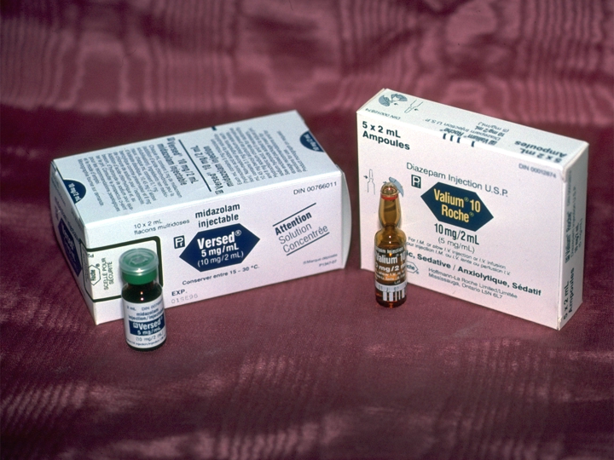
Not practical

Slide 137
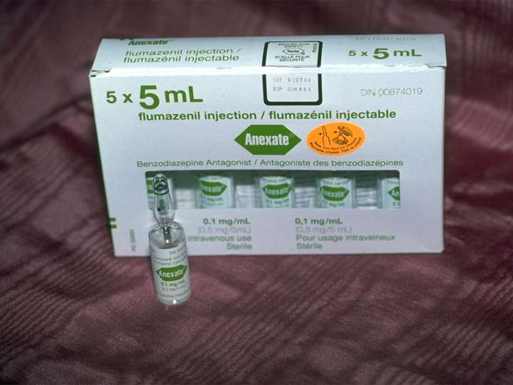
Not practical

Slide 138
Diabetic Emergencies
Overview of pathogenesis:
Angina
Silent MI
Insulin Lack
Insulin Excess
Aneurism
Heart Failure
Treatment: Syncope Protocol

Slide 139
Diabetic Emergencies
ALWAYS (almost) is INSULIN SHOCK, = SIGNIFICANT HYPOGLYCEMIA:
Thirst
The “6 black coffee” syndrome
Shakes, diaphoresis, pallor
Confusion, restlessness
“I feel faint” ➔ LOC

Slide 140
Hypo(er)glycemia Algorithm
ABC’s & Position
⬇
Oxygen
⬇
Glucose

Slide 141
Unexplained, Unwitnessed, Unconscious
(or you, you, you!)
Primary assessment
Call for HELP, get to a phone even if it’s you that has to leave
No medical history, no relatives, no knowledgable friends

Slide 142
IN LIFE…triple “U”
Unexplained, Unwitnessed, Unconscious
Look for MEDIC ALERT bracelet or necklace
Read allergies, medical conditions
Phone emergency hot line # on MEDICAL ALERT tag, quote victim’s ID #
Medical history will be given 24 / 7 by phone

Slide 143
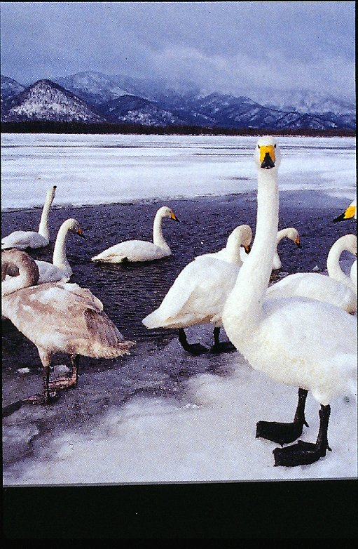
Medical / Dental
Emergency Quiz

Slide 144
M
A
R
C
H
2
0
1
3
Medical Emergencies in the Dental Office
Medical Emergencies in Life
Utah Dental Association
Salt Lake City, UT
Mel Hawkins, DDS
Dentist/Dentist Anesthesiologist
Toronto, ON Canada
www.sedationdentistry.us melhawkins@rogers.com

